Slide 1
Linux command line and nf-core introduction
Edoardo Piombo

Slide 2
Let’ download stuff
Windows people should do the following:
download moba X term from here: https://mobaxterm.mobatek.net/
Do “new session”
Choose “shell”
Choose “bash”
Enter “open /home/mobaxterm” to open the directory in the file explorer
People using Macs or Linux just need to open a terminal:
Mac: https://support.apple.com/guide/terminal/open-or-quit-terminal-apd5265185d-f365-44cb-8b09-71a064a42125/mac
Linux: https://ubuntu.com/tutorials/command-line-for-beginners#3-opening-a-terminal

Slide 3
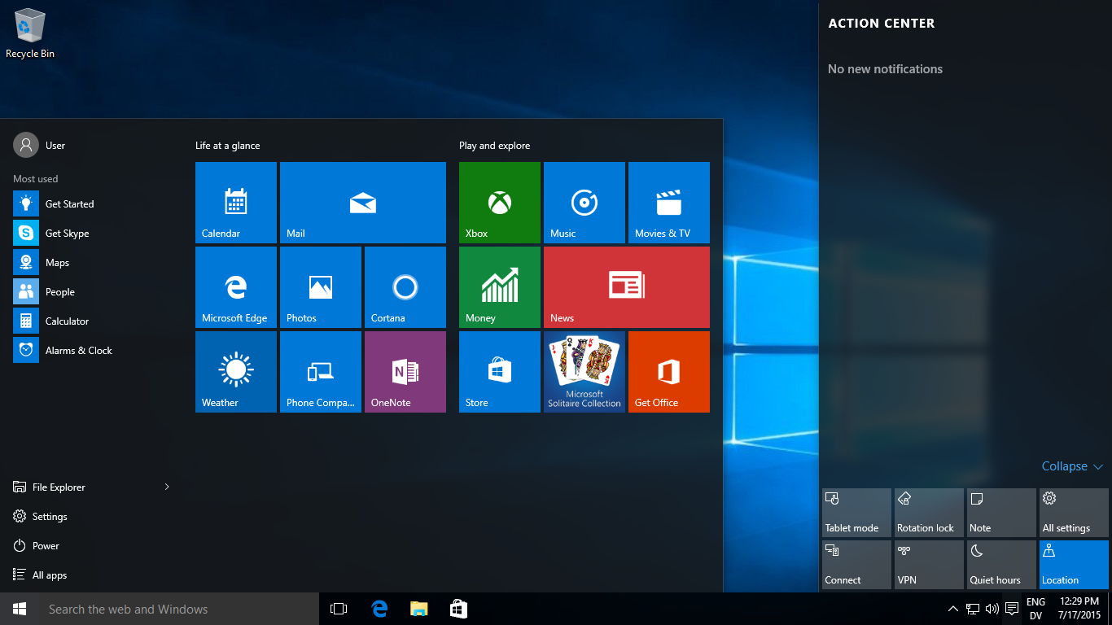
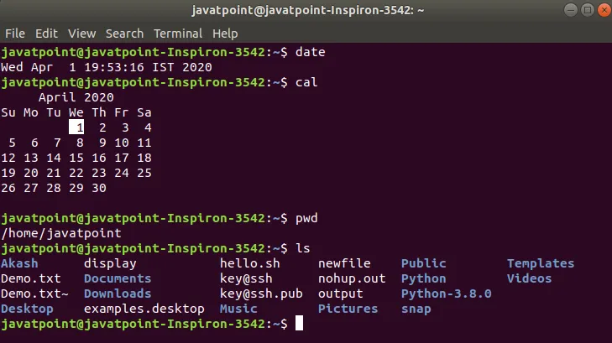
There are different ways of interacting with computers
Graphical user interface (GUI)
Command-line (or text) interface (CLI). Also called shell

Slide 4
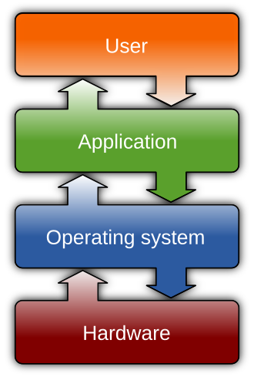
Linux
Operating system (OS)
Microsoft Windows, MacOS, and Linux
Linux – Versatile, open source, free, used on supercomputers.
The most common way to run complex bioinformatic
analyses, on supercomputers or your own pc,
is to use the Bash shell.

Slide 5
What we will do today
Tutorial about the bash shell
Break
Learning about nf-core
Exercise about nf-core

Slide 6
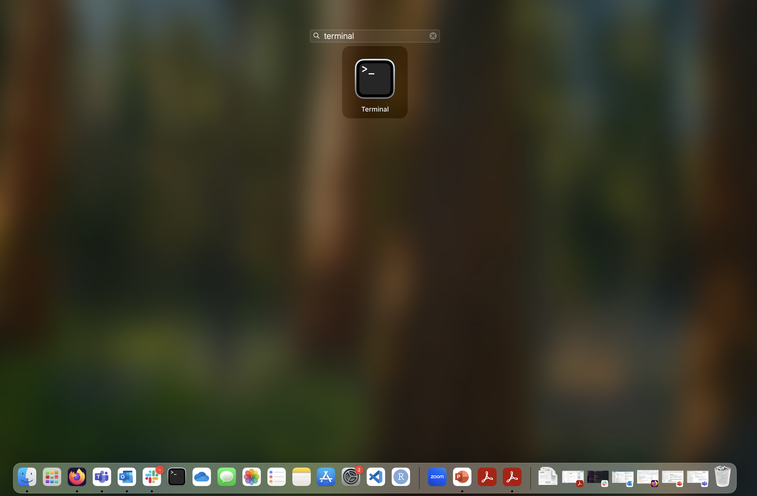
Open a terminal: Mac
Open launchpad
Write “terminal” in the search bar.
Click on Terminal

Slide 7
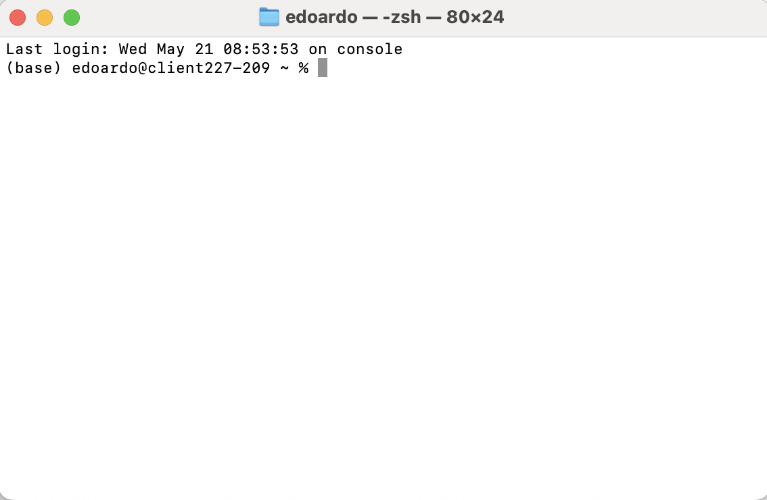
Open a terminal: Mac
You should see something like this

Slide 8
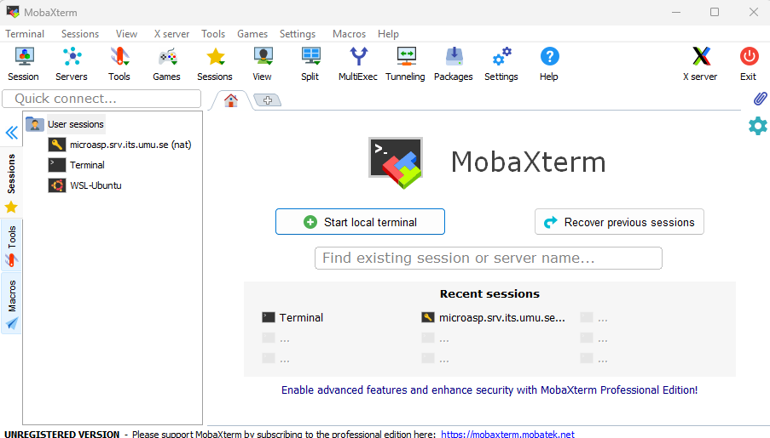
Open a terminal: Windows
Open MobaXterm
Start a new session

Slide 9
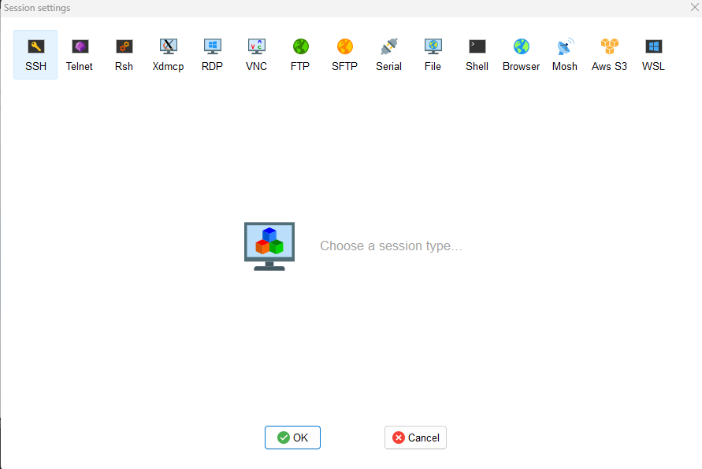
Open a terminal: Windows
Open MobaXterm
Start a new session
Select “shell”

Slide 10
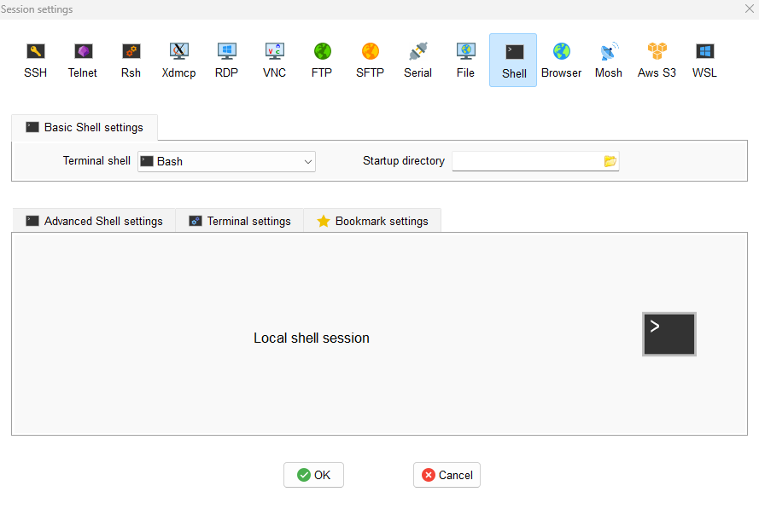
Open a terminal: Windows
Open MobaXterm
Start a new session
Select “shell”
Select an empty startup directory or make a new one

Slide 11
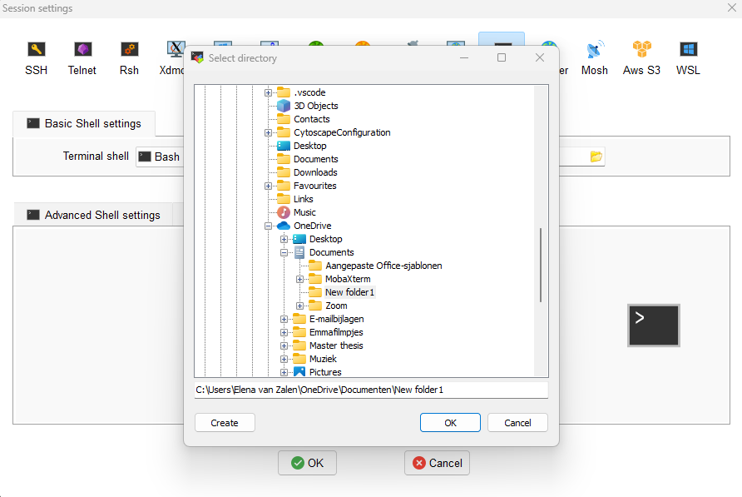
Open a terminal: Windows
Open MobaXterm
Start a new session
Select “shell”
Select an empty startup directory or make a new one

Slide 12
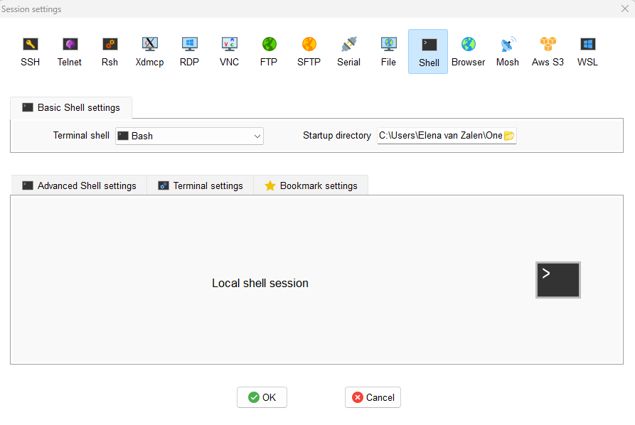
Open a terminal: Windows
Open MobaXterm
Start a new session
Select “shell”
Select an empty startup directory or make a new one
Click “OK” to open a terminal

Slide 13
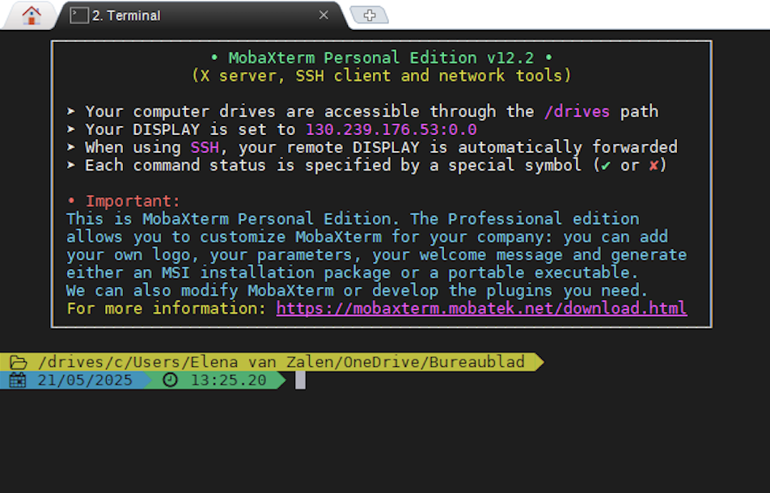
Open a terminal: Windows
Open MobaXterm
Start a new session
Select “shell”
Select an empty startup directory or make a new one
Click “OK” to open a terminal
You should see something like this

Slide 14
Software carpentry tutorial
Go to this link:
https://swcarpentry.github.io/shell-novice/index.html Follow the instructions, completing these two sections:
1: Introducing the Shell
2: Navigating Files and Directories

Slide 15
What is nf-core?
From their website: A global community effort to collect a curated set of open‑source analysis pipelines built using Nextflow.
When starting a new project requiring bioinformatics analyses, it is not a bad idea to check the nf-core website to see if they have a pipeline prepared to run the analysis of the type of data you have:
https://nf-co.re/

Slide 16
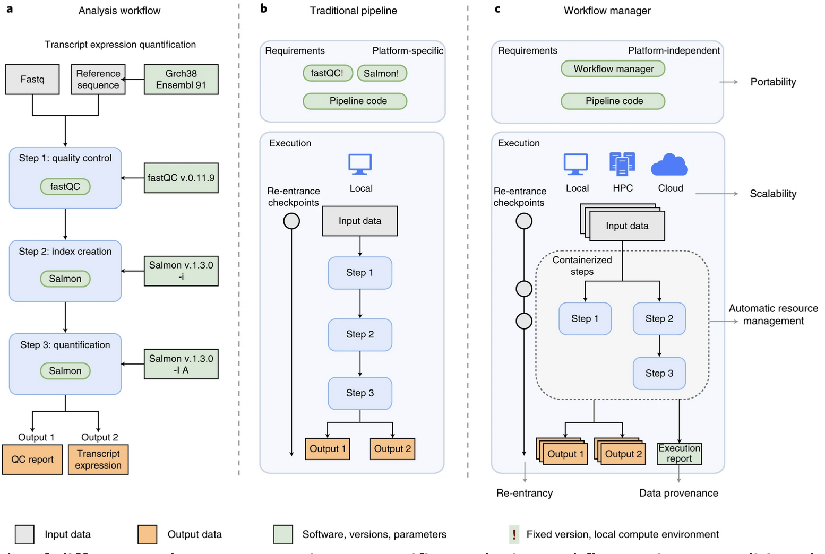
Visually:
Nextflow is the software allowing this
Nf-core is a repository of nextflow pipelines built for different bioinformatics applications
Source:
Wratten, L., Wilm, A. & Göke, J. Reproducible, scalable, and shareable analysis pipelines with bioinformatics workflow managers. Nat Methods 18, 1161–1168 (2021)

Slide 17
How to edit files
In the rest of the lesson, you will edit a variety of files. They are all txt files organized in specific ways, such as json files.
To edit them, use simple text editors and not word, as word tends to add metacharacters that are not correctly interpreted by the softwares we will use.
Good text editors to use are TextEdit (for Mac) and Notepad or WordPad (for windows).
A more complex one to use (very good, but with many functionalities that may be confusing) is VScode (https://code.visualstudio.com/download), which works on every system.

Slide 18
Running the rnaseq pipeline
Download my github repository by entering in your shell the following command:
git clone https://github.com/EdoardoPiombo/nf-core-introduction.git
Follow the instructions in the READme file to do the exercise.
You have solutions in the “solutions” folder if you are stuck.
When you are done, feel free to check out the other pipelines and see if there is something that could help you with your work:
https://nf-co.re/pipelines/

